Slide 1
Fabric tracker design thoughts
2024.05

Slide 2
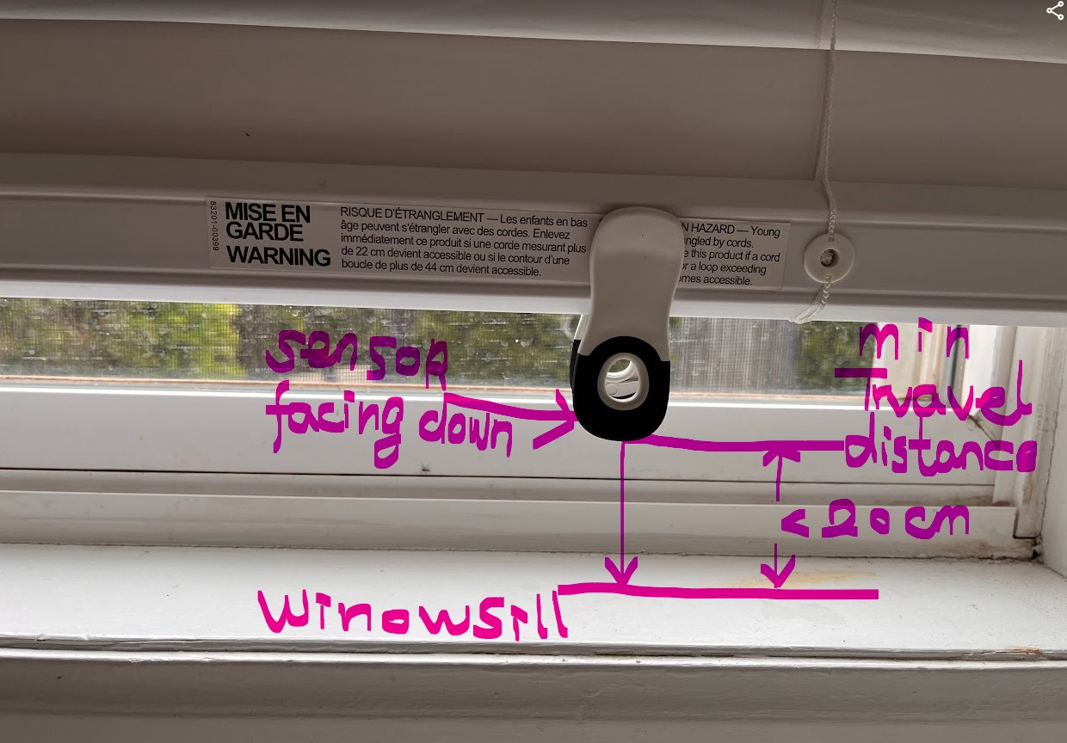
Inatallation
Fabric tracker is installed on the bottom rod and looks like a clamp on the bottom rod.
Time-of-flight sensor is facing down and measure the distance between the sensor and the window sill

Slide 3
Operation
Assume that the shade move 10cm/s.
The sensor will measure the distance every 2S.
The sensor will report each measure that is <=20cm to SmartShade and Smartshade can compensate.

Slide 4
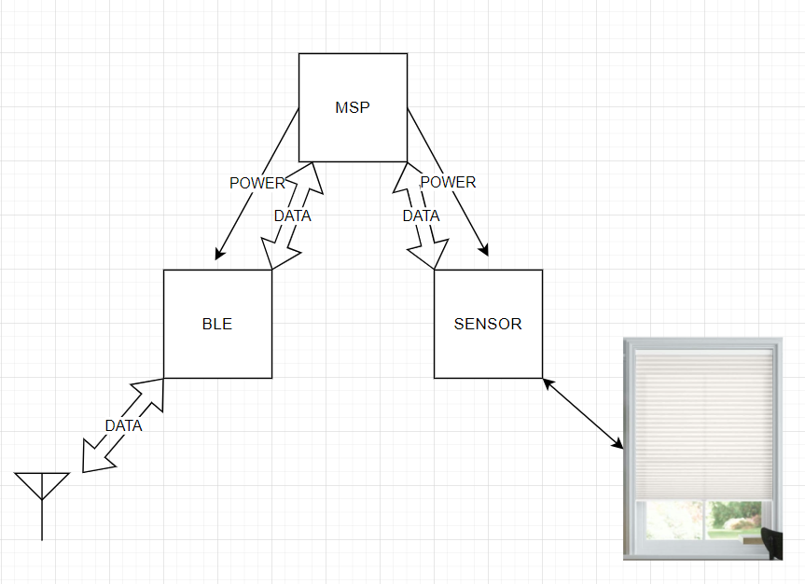
Diagram
MSP controls the power of BLE module and TOF sensor
MSP get data from TOF and sent it through BLE to Smartshade

Slide 5
Multi-host and other issues
The Fabric tracker will be a host in BLE connection.
Conflicts when Fabric tracker try to sent message and SmartShade is connected to a Mobile, Bridge or Remote ???
Maybe message sent via broadcasting ???

Slide 6
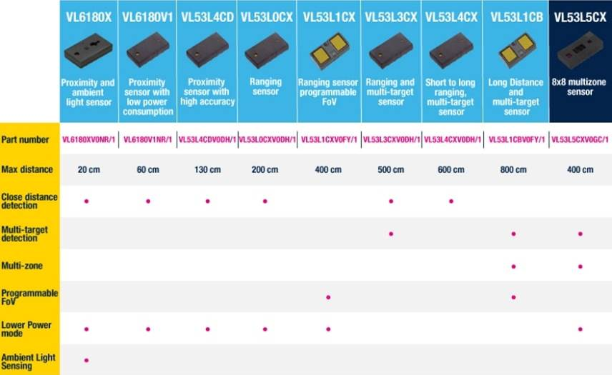
TOF sensor

Slide 7
BLE module
ESP32-C3 single chip
ESP32-C3-MINI-1-N4
ESP32-C3-WROOM-02

Slide 8
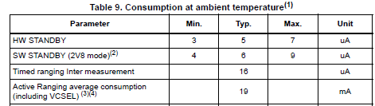
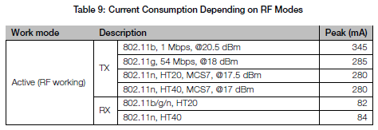
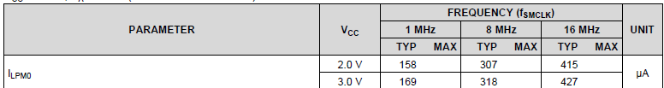
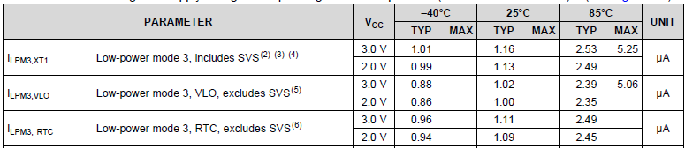
Power consumption
Power consumption of TOF sensor(2s interval)
Power consumption of BLE module(ESP32-C3-WROOM-02U-N4).
(it only works when d <20 cm is detected and only report once.)
Power consumption of MSP MCU(MSP430FR2311 as example)
standby all the time

Slide 9
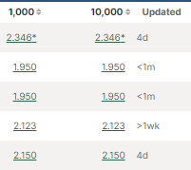
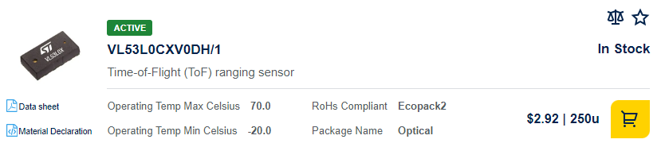
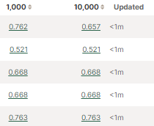
Cost estimate
ESP32-C3-WROOM-02U-N4
VL53L0X
MSP
A boost converter
Battery
Plastic

Slide 10
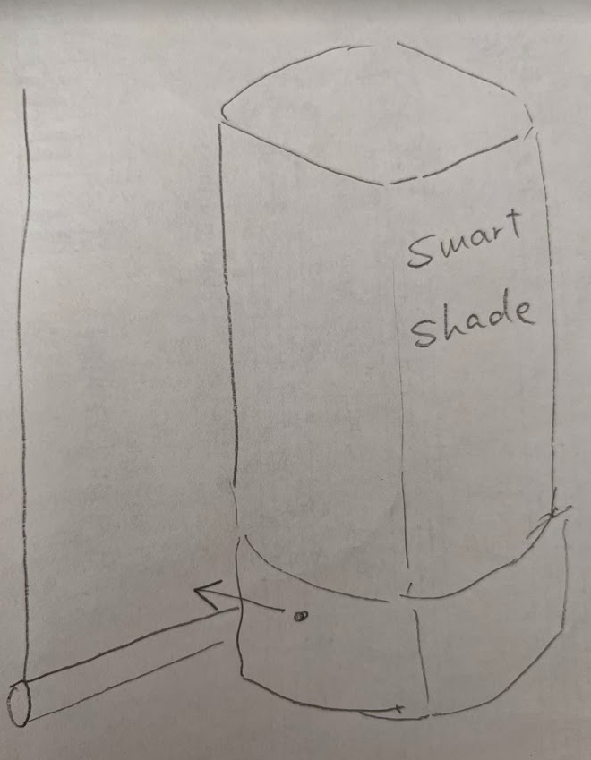
The other way to communicate
Fabric tracker is a z-wave like accessary. It attaches the Smartshade and use MFP to communicate.
The sensor detect if the window shade is blocking or not.
It save the money spend on BLE module and batteries.

Slide 11
Use a buzzer or ultrasound to communicate
We need to modify Smartshade
Can not share time stamp and other details?

Slide 12
Design support
FW
FW in SmartShade monitors messages from Fabric tracker.
Decode timestamp and sensor value.
Do necessary smooth and average.
Estimate speed of window shade.
Do compensation
ID
Concepts
Mechanical
Mechanical design, demo, tooling
Mobile
At configuration state, Mobile scan a code on Fabric tracker(maybe MAC)
Sync time stamp, position, and speed.

